Slide 1



Subreddits Classification
Feras Altwal, DSIR-824

Slide 2
Problem statement
To Classify posts from two subreddits:
NBA and Soccer

Slide 3
Subreddits
NBA:
50K post titles
July 26, 2020 – October 8, 2020
Soccer:
50K post titles
July 13, 2020 – October 8, 2020

Slide 4
Workflow
Data Collection
Data Cleaning
Visualization
preprocessing
Modeling
Validation
Pushshift API
Merge data
Remove duplicates
Word frequency
Title length
CountVectorizer
TfidfVectorizer
Logistic Regression
Naïve Bayes
Random Forest
Precision
Accuracy

Slide 5
Data Collection
Pushshift API
Collected 50K posts for each subreddit:
title, created utc, selftext, subreddit, author, permalink

Slide 6
Data Cleaning
Combined NBA and Soccer subreddits
Removed duplicates (5261 duplicate posts)
Target: NBA: 0, Soccer: 1

Slide 7
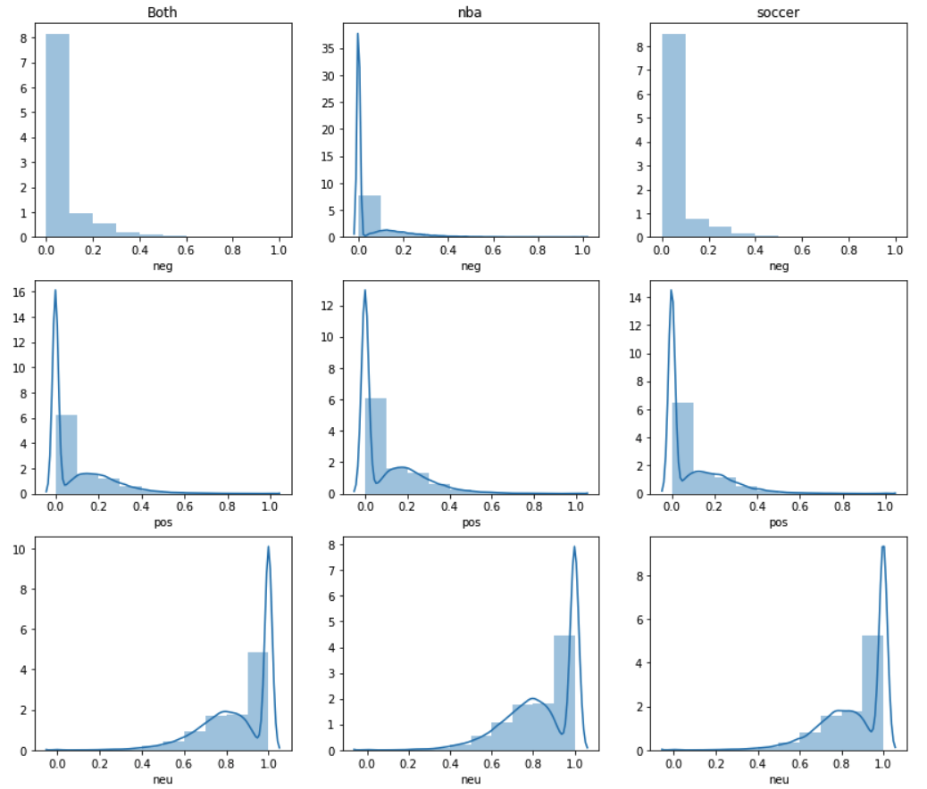
Sentiment analysis
Both
NBA
Soccer

Slide 8
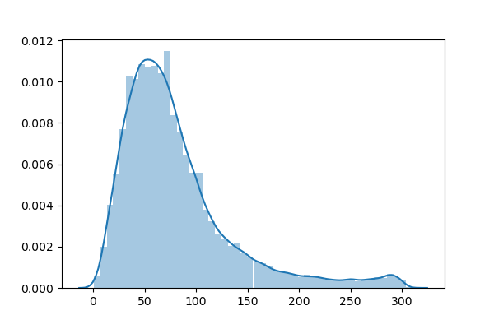
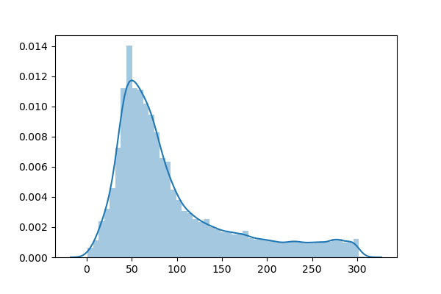
Title length
NBA
Soccer
Frequency
Frequency
Character length
Character length

Slide 9
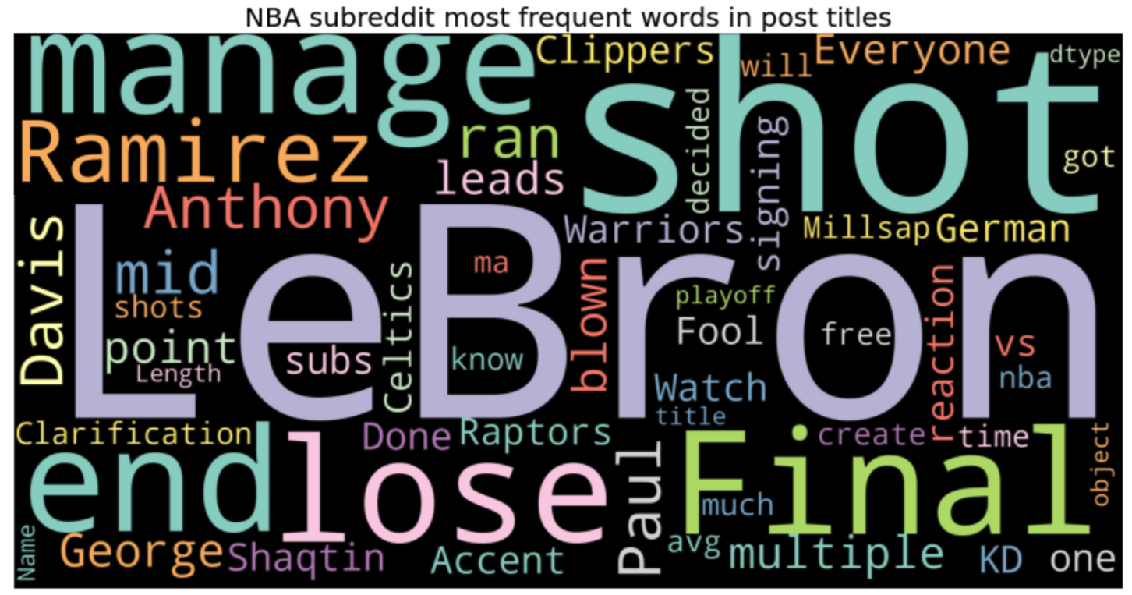
Most Used words

Slide 10
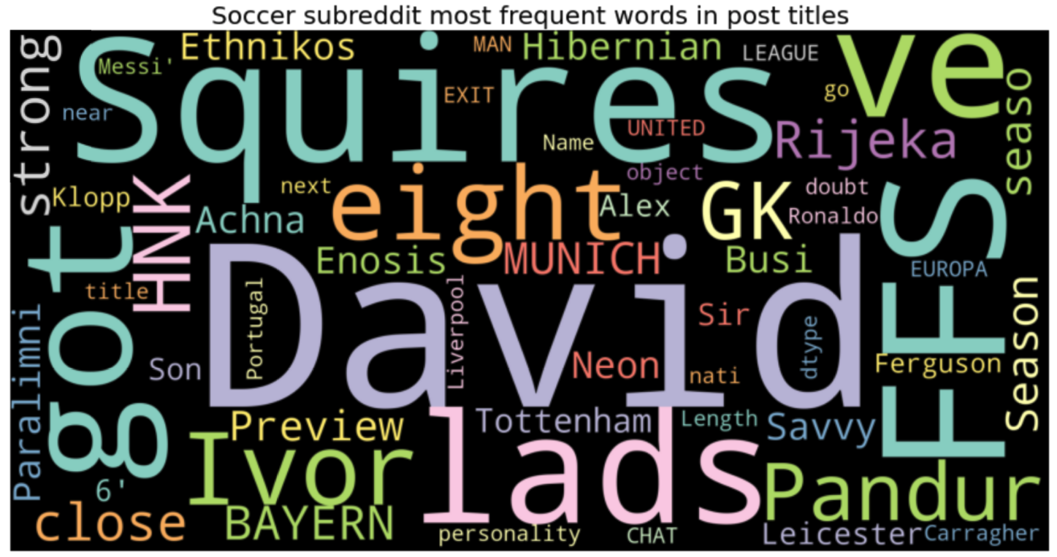
Most Used words

Slide 11
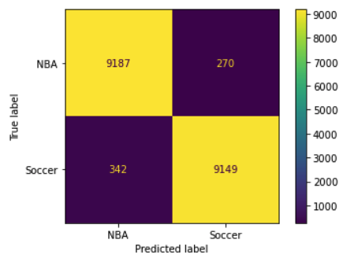
Modeling Logistic Regression
Logistic Regression
Training score: 0.998
Testing score: 0.968
Precision: 0.971
Accuracy: 0.968

Slide 12
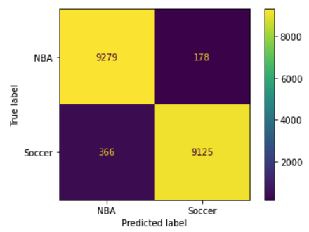
Modeling Naïve Bayes
Naïve Bayes
Training score: 0.989
Testing score: 0.971
Precision: 0.980
Accuracy: 0.971

Slide 13
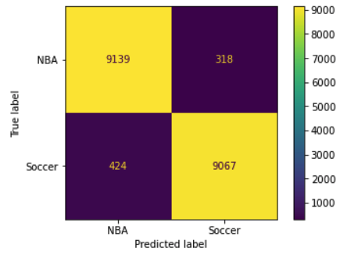
Modeling Random Forest
Random Forest
Training score: 0.999
Testing score: 0.960
Precision: 0.966
Accuracy: 0.960

Slide 14
Validation
 | Training score | Testing score | Precision | Accuracy
Logistic Regression | 0.998 | 0.968 | 0.971 | 0.968
Naïve Bayes | 0.989 | 0.971 | 0.980 | 0.971
Random Forest | 0.999 | 0.960 | 0.966 | 0.960

Slide 15
Conclusions & Future work
CountVectorizer with Naïve Bayes performed the best
Logistic regression is also a good model (needs tuning)
Future work:
Try other classification models (e.g. SVC)
More tuning with hyperparameters to improve models
Include lemmatization and stemming
Streamlit, to make the model available for use

Slide 16


Questions?

